Slide 1
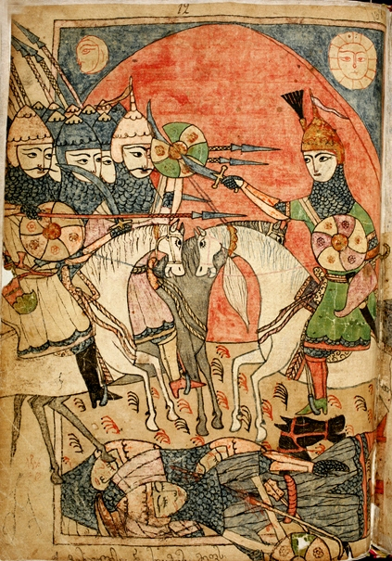
Heroes as Narrators in Georgian Folktales
Elene Gogiashvili
Ivane Javakhishvili Tbilisi State University
Department of Folkloristics

Slide 2
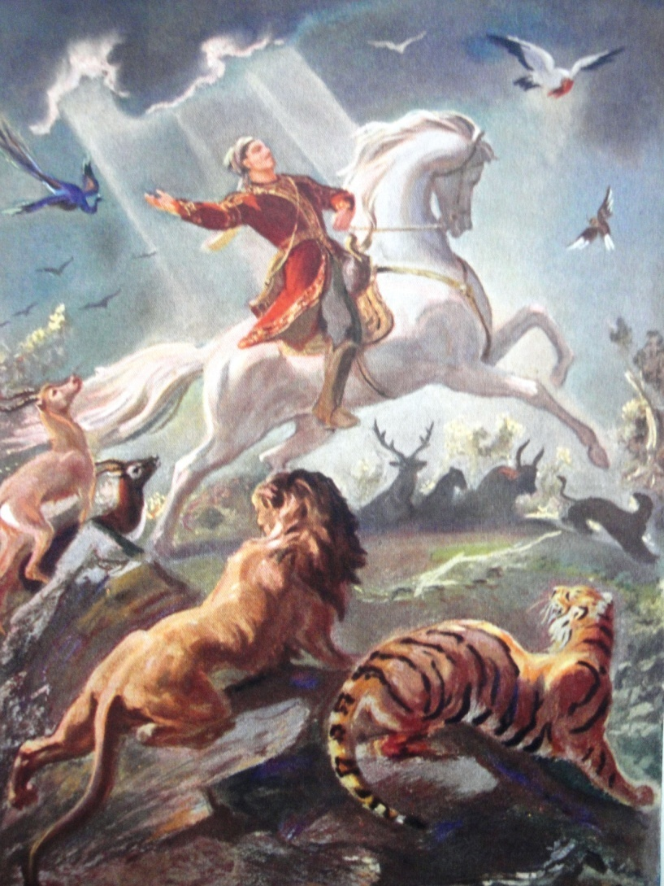
Mythological, epic and literary heroes in one folktale
Amiran
Tariel
Rostom

Slide 3
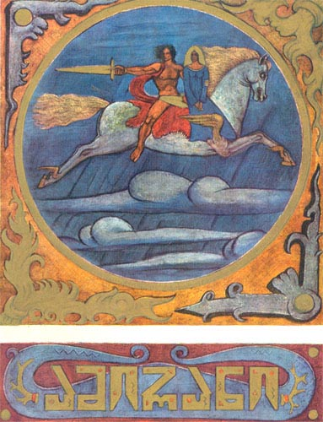
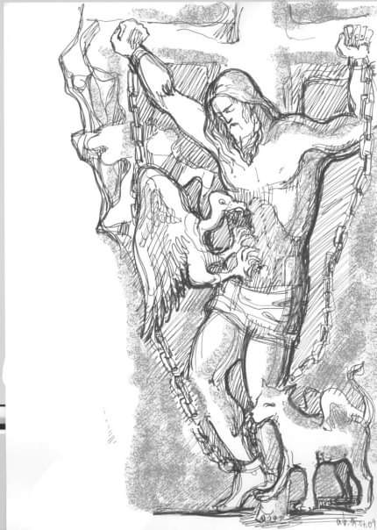
Amiran - a mythological hero, chained in a cave in the mountains of the Caucasus.

Slide 4
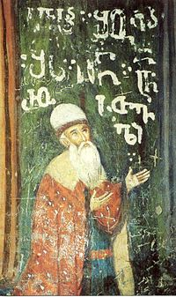
Tariel - a protagonist of the poem The Knight in the Panther’s Skin by Shota Rustaveli
Shota Rustaveli fresco in the
Monastery of the Cross in Jerusalem
13th century

Slide 5
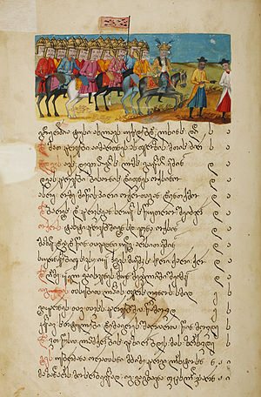
Rostom - a character of the poem Shahnameh by Firdawsi, Persian writer of the eleventh century.
Georgian manuscript of Shahnameh
17th century

Slide 6
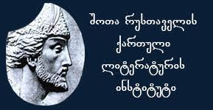

Archival sourses
Folklore Archive of Shota Rustaveli Institute of Georgian Literature
Archive of the State Folklore Centre of Georgia

Slide 7
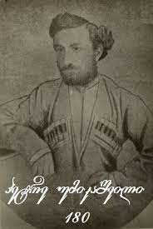
Variants
recorded by Petre Umikashvili, a Georgian folklorist, in 1871 (Shota Rustaveli Institute of Georgian Literature).
recorded by M. Khutsishvili in 1937 (Archive of the State Folklore Centre of Georgia).

Slide 8
Once the three heroes - Amiran, Tariel and Rostom met. ‘Let us tell our stories! Which of them is the most marvellous?’ they said.
First, Rostom told his adventure: One night I met a man in the field. He was as small as a thumb. I asked him: ‘Where are you going?’ He answered: ‘I am going to steal the herd of horses which belong to Rostom, and where are you going?’ I told him that I was going to steal the herd of horses which belonged to Rostom too. We approached the herd. The marvellous man swooped over the wall. He threw horses upon horses. I was astonished. ‘Who are you?’ I asked him, ‘Are you afraid of anything?’ The marvellous man told me: ‘I am afraid only of a scream of Rostom and a neigh of his horse.’ When I heard this, I screamed. My horse neighed and, the small man disappeared. That was the most marvellous story in my life.

Slide 9
Then Tariel told this story: Once, after a war, eleven knights and myself were lost in the forest. Suddenly we saw an enormous skull. We went inside it and spent the night in there. Next morning we wanted to know whose skull that was. We wished to see that creature alive. We started to pray. After a while, the skull began to grow. Finally, the man woke up. He was as big as a giant. ‘Who are you? How could you breathe new life into me?’ asked the giant. Then he saw the fields and mountains around and became sad: ‘Everything is changed. Everything is a colour of blood. This world has become sinful.’

Slide 10
He asked us to show him the bread we ate. We gave him our bread. Blood trickled from the bread. ‘Do you see how full of blood your world is? In my times, milk used to trickle from bread. I would not like to live in your evil world. Please pray to return me to my previous condition!’ We prayed and the giant turned into the skull again. That was my story.

Slide 11
Finally, Amiran told his story: Once I saw a red river. I went to its mouth in the mountain and saw a black giant sitting on the hill. He was holding his spear in front of him. When he dozed, he cut his forehead on the spear and bled profusely. That’s why the water in the river was red. I asked the black giant what was going on. He answered: ‘I am waiting for a white giant. He is accompanying a beautiful woman. I want to steal the woman from him. When they approach us, the beauty of the woman will brighten up the world. Please wake me up and wait while I am wrestling with the white giant. If you see that the white giant is stronger than me, then scream. The white giant will be scared and run away.’ The giant fell asleep.

Slide 12
Finally, the white giant and the beautiful woman arrived. I woke the black giant and they started to fight. The black giant beat the white giant, but he got wounded and died too. The woman asked me to bury the dead giants. I brought a chart. The woman put the corpses on the chart. One giant’s leg dropped from the chart. The woman asked me to set the leg right. I tried but I could not even raise the leg of the giant. The woman became angry and left me. That was my story.
The three knights swore eternal friendship to each other.

Slide 13
The Tale of the Three Knights in a frame
Amiran, Tariel and Rostom meet each other and tell their stories.
Amiran´s tale | Tariel´s tale | Rostom´s tale
 | Inserted story in the Tariel´s tale
The three knights swear eternal friendship to each other.

Slide 14
The stories have folkloric origins related with the motifs:
Mot. D1311.8: Divination by head
Mot. D 1610.5: Speaking head
Mot. F 531.1.0.1.1: Beautiful giantess
Mot. F 531: A person of enormous size
Mot. F 531.2.3: Giants skull holds a man seated
Mot. F 531.6.8.3.3: Giants wrestle with each other
Mot. F 302.4: Man obtains power over fairy mistress

Slide 15
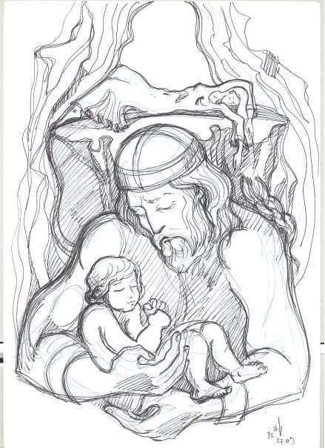
Amiran is a son of the pagan goddess, but his godfather is Jesus Christ.
Illustration
by
Tamar Khoshtaria

Slide 16
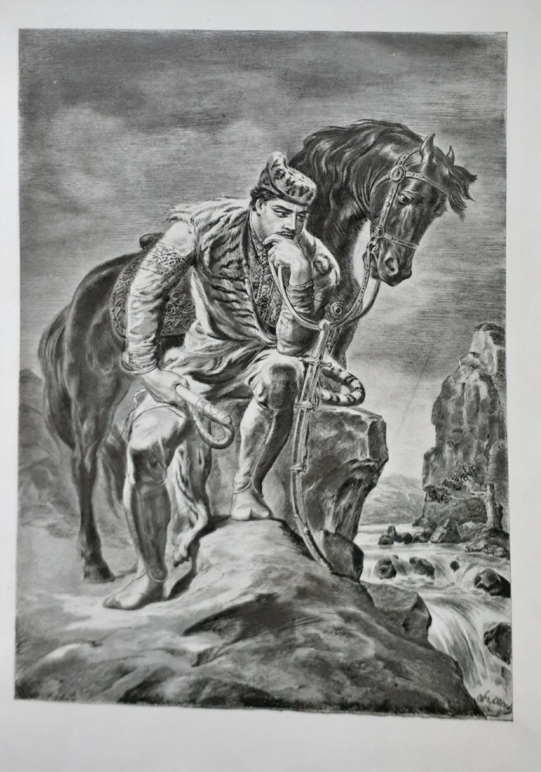
Tariel – distinguished by his wild character as symbolized by his wearing the panther´s skin, an image of a passionate person and true love.
“The history of the poem makes it worthy of perusal, for it has been in a unique manner the book of a nation for seven hundred years; down to our own days the young people learned it by heart; every woman was expected to know every word of it, and on her marriage to carry a copy of it to her new home.”
Marjory Wardrop, the first English translator of The Knight in the Panther’s Skin
Illustration by Irakli Toidze

Slide 17
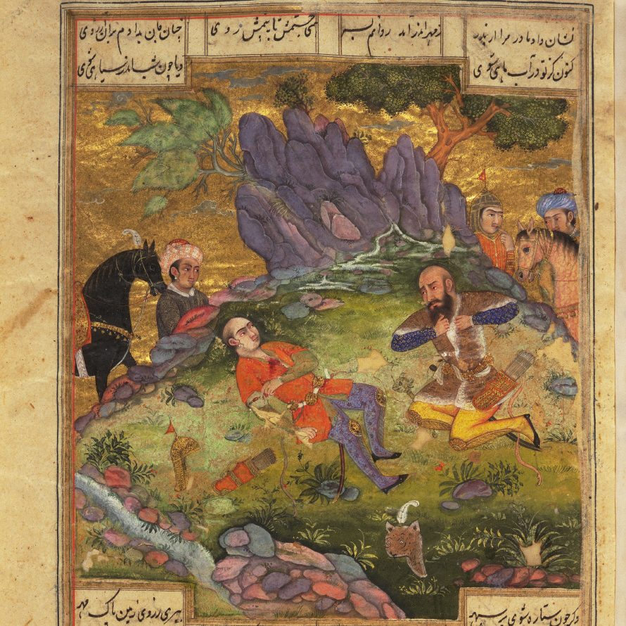
Rostom – a character who fought and killed his own son Sohrab in the battle.
The stories of Rostam and Sohrab became part of Georgian folklore.
The horse of Rostom, called Raksh, became a universal name of a fairy-tale winged horse in Georgian lexica (‘Rashi’).

Slide 18
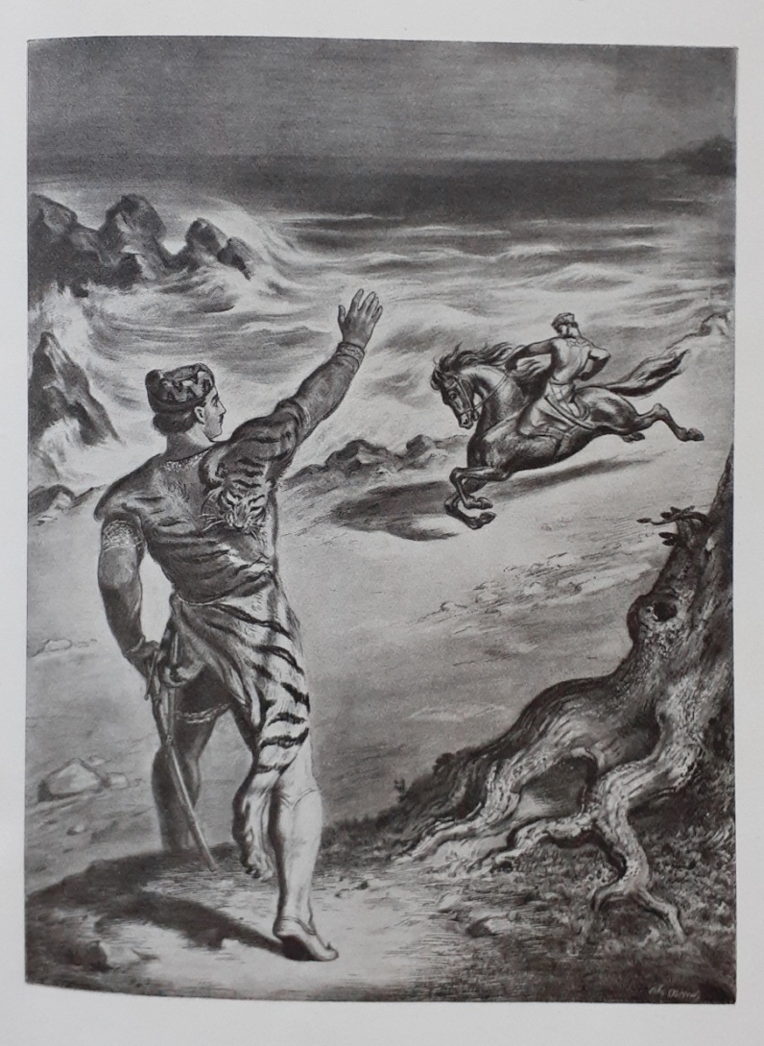
In ethnographic reality and everyday Georgian vocabulary
‘Tariel’ is a synonym of a handsome and powerful young man.
‘Amiran’ and ‘Rostom’ mean strong and well-built men.

Slide 19
Thank you for your attention!

